Slide 1
SUVETHA S Nm Id:au962821104098
Final Project

Slide 2
IMAGE CLASSIFICATION IN NEURAL NETWORKS

Slide 3
Introduction to Image Classification
1. Image classification is a computer vision task that involves categorizing images into predefined classes or categories.
2. It plays a crucial role in various applications such as object detection, medical diagnosis, and autonomous vehicles.
3. Neural networks, especially Convolutional Neural Networks (CNNs), are commonly used for image classification due to their ability to learn hierarchical features.

Slide 4
Convolutional Neural Networks (CNNs)
1. CNNs are a type of neural network architecture designed specifically for processing structured grid data, such as images.
2. They consist of multiple layers, including convolutional layers, pooling layers, and fully connected layers.
3. CNNs use convolutional operations to extract features from input images, capturing spatial hierarchies of patterns.
4. The output of CNNs is passed through a softmax layer to produce class probabilities, enabling classification.

Slide 5
Training Data and Preprocessing
1. Successful training of an image classification model requires a large and diverse dataset of labeled images.
2. Preprocessing techniques such as normalization, data augmentation, and resizing are often applied to images to improve model generalization.
3. Data augmentation involves applying transformations such as rotation, flipping, and scaling to increase the diversity of training data.
4. Additionally, techniques like transfer learning can be employed to leverage pretrained models and fine-tune them on specific image classification tasks.

Slide 6
Model Training and Evaluation
1. During training, the parameters of the neural network are optimized using techniques like gradient descent and backpropagation.
2. The performance of the trained model is evaluated using various metrics such as accuracy, precision, recall, and F1 score.
3. Cross-validation techniques like k-fold validation are commonly employed to assess the model's generalization ability.
4. Hyperparameter tuning is crucial for optimizing the performance of the model and preventing overfitting.

Slide 7
Applications of Image Classification
1. Image classification has diverse applications across various domains, including healthcare, agriculture, surveillance, and e-commerce.
2. In healthcare, it is used for diagnosing diseases from medical images such as X-rays, MRIs, and CT scans.
3. In agriculture, image classification aids in crop monitoring, disease detection, and yield estimation.
4. Other applications include facial recognition, content moderation, and product recommendation systems.

Slide 8
Challenges in Image Classification
1. Image classification faces challenges such as occlusion, viewpoint variation, illumination variation, and background clutter.
2. Limited availability of labeled data for certain classes can hinder model performance, leading to biases and inaccuracies.
3. Overfitting, where the model performs well on training data but poorly on unseen data, is a common issue that needs to be addressed.

Slide 9
Future Trends in Image Classification
1. Future advancements in image classification are likely to focus on improving model interpretability and robustness to adversarial attacks.
2. Integration of techniques such as attention mechanisms and graph neural networks may enhance the ability of models to capture global dependencies and long-range correlations.
3. Federated learning approaches could enable collaborative model training across distributed datasets while ensuring data privacy and security.

Slide 10
Conclusion
1. Image classification using neural networks has revolutionized the field of computer vision, enabling automated analysis and understanding of visual data.
2. Despite challenges, ongoing research and advancements in deep learning techniques are continuously improving the accuracy and efficiency of image classification models.
3. The widespread adoption of image classification technology across various industries highlights its significant impact on society and the economy.

Slide 11
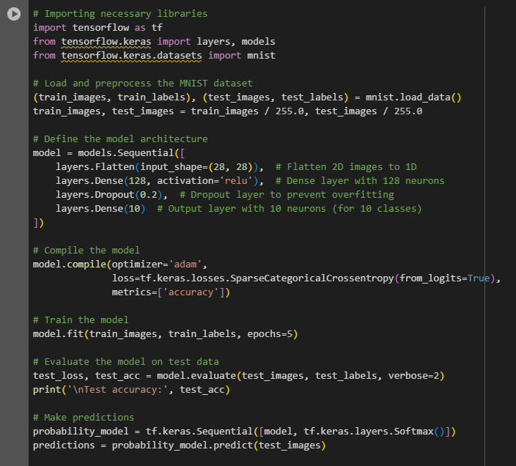
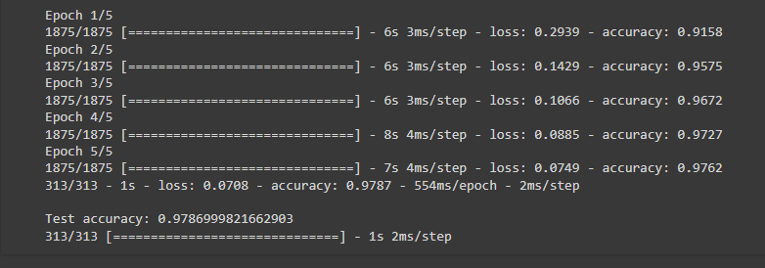
Result

